Slide 1
BIZ06 – Bahasa Inggris 2

Slide 2
UNIT 4 Targeting the customer
Meeting 6 – 7

Slide 3
Specific Competence
Students are able to use the rules of the first conditional, and adverbs of manner in business situation Students are able to use the language expressions to talk about commercials and advertising, and write formal and informal language in emails (C3)

Slide 4
1. First conditional

Slide 5
1.1 First Conditional
First conditional is used to talk about things which might happen in the future. Of course, we can't know what will happen in the future, but this describes possible things, which could easily come true.
If it rains, I won't go to the park.
If I study today, I'll go to the party tonight.
If I have enough money, I'll buy some new shoes.
She'll be late if the train is delayed.
She'll miss the bus if she doesn't leave soon.
If I see her, I'll tell her.

Slide 6
1.1 First Conditional
The first conditional has the present simple after 'if', then the future simple in the other clause:
if + present simple, ... will + infinitive

Slide 7
1.1 First Conditional
If you want to, you can put the part with will + bare infinitive verb at the beginning of the sentence. It will mean exactly the same thing. You won’t need the comma to separate the parts.
I won’t go to the beach if it rains.
I’ll go to the party tomorrow if I study today.
I’ll buy the concert tickets if I have enough money.
He’ll be late if traffic is bad.
She’ll fail the test if she doesn’t study.
I’ll tell her if I see her.

Slide 8
Practice 1
Complete the Conditional Sentences (Type I) by putting the verbs into the correct form.
If you (send) this letter now, she (receive) it tomorrow.
If I (do) this test, I (improve) my English.
If I (find) your ring, I (give) it back to you.
Peggy (go) shopping if she (have) time in the afternoon.
Simon (go) to London next week if he (get) a cheap flight.
If her boyfriend (phone / not) today, she (leave) him.
If they (study / not) harder, they (pass / not) the exam.
If it (rain) tomorrow, I (have to / not) water the plants.
You (be able/ not) to sleep if you (watch) this scary film.
Susan (can / move / not) into the new house if it (be / not) ready on time.

Slide 9
2. Adverbs of manner

Slide 10
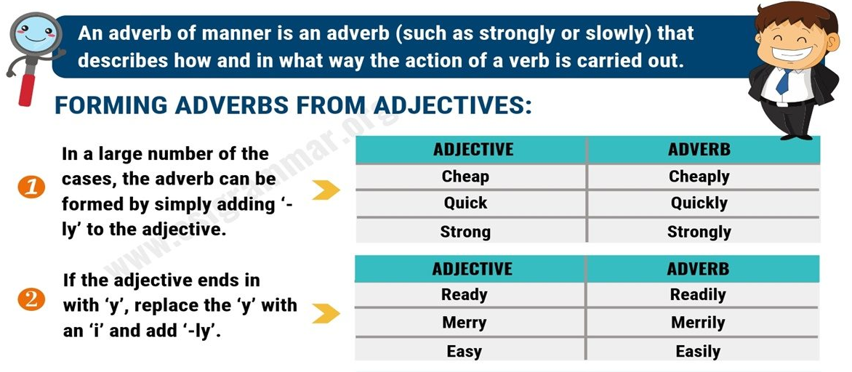
2.1 Adverbs of manner
Adverbs of manner mainly modify verbs and tell us the way in which something happens.

Slide 11
Practice 2
Open page 29 to answer questions on part G and I

Slide 12
3. Vocabulary

Slide 13
3.1 Advertising words
Check the meaning of these words in a dictionary.
Commercial
To go viral
To target
To promote
Campaign
Slogan
To advertise
To annoy
To delete
Consumer
Ads = advertisements
To solve
Technician
Satisfied
To damage

Slide 14
3.2 Easily confused words (1)
If vs when
Tell vs say

Slide 15
3.2.1 If vs. When
We use if to introduce a possible or unreal situation or condition. We use when to refer to the time of a future situation or condition that we are certain of:
You can only go in if you’ve got your ticket.
When I’m older, I’d love to be a dancer.

Slide 16
3.2.1 If vs. When
If Giles comes back to the office, can you tell him I’ve gone home. | The speaker does not know whether Giles is coming back to the office. It is possible, but not definite.
When Giles comes back to the office, can you tell him I’ve gone home. | The speaker is certain that Giles is coming back to the office.

Slide 17
3.2.2 Tell vs. Say
Tell is followed by a person:
➔ Can you tell me the way to the situation?
Say is not followed by a person.
➔ What did he say?
BUT say + to + person:
➔ What did he say to you?

Slide 18
Practice 3
Open page 31 to answer questions part A, B and C.

Slide 19
Practice 3
Part II. say or tell? – Choose the correct answer.
Can you ____ me the way to the station, please?
He didn't ____ a word.
She ____ her name was Sue.
Let me ____ you something about my hobbies.
Forget everything I just ____.
Why didn't you ____ him that before?
Why didn't you ____ that before?
They ____ nothing to me.
You don't need to ____ us that.
What did Eric ____ when he saw the new bike?

Slide 20
4. Business Writing: formal and informal language in emails.

Slide 21
4.1 Elements of Email
The main difference between these two types of emails is that formal writing is straight to the point, less detailed, and informative sentences are written in a passive tone. Informal writing, on the other hand, uses descriptive words and is written with an active voice.
Passive voice (formal): “Krystal’s reservation has been confirmed for Friday.”
Active voice (informal): “Krystal received a confirmation email saying that her reservation has been confirmed for Friday.”

Slide 22
4.1 Element of Email
Some things to avoid when writing formal emails
Colloquial words: “wanna” (want to), Y’all (You all)
Contractions: Can’t, Didn’t, Haven’t
Clichés: I will have email you the report in a jiffy. Vs. I will email you the report as soon as possible.
Abbreviated words: ASAP, lol, P.S
Imperative words or sentences: Stop, Do this, Go ahead

Slide 23
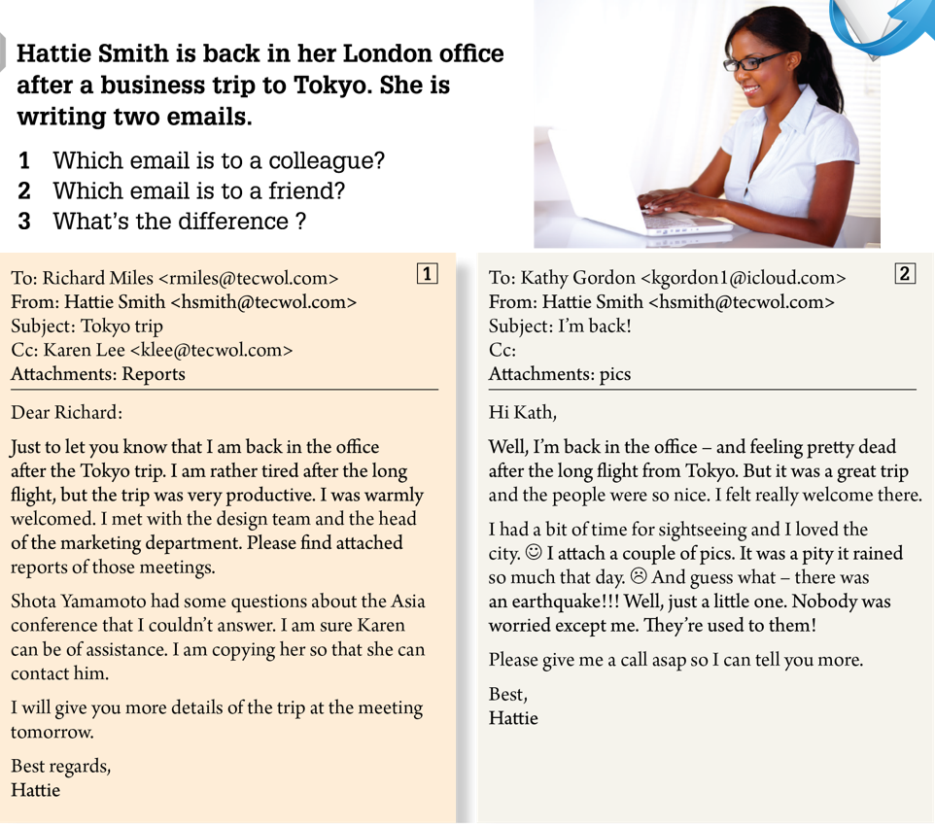
4.2 Formal vs Informal Email

Slide 24
5. Listening Activity

Slide 25

Practice 4
Play the audio file track 14 to answer the questions part A and B on page 27

